Slide 1
SAP UI5 – Intermediate Level

Slide 2
SAP UI5 – Day 2

Slide 3
UI5I-UI5: UI Data Binding

Slide 4
Agenda
Data Binding Basic Concepts
Types of Models
Hands On Demonstration for data binding using various mock data to be created during the session
Best Practices
Formatter
Validations- Introduction of Regex
Fragments

Slide 5
UI5I-UI5-01 : Binding Concepts in UI5

Slide 6
Data Binding
In SAP UI5, data binding concept is used to update the data automatically by binding the data with the controls that holds the application data. Using data binding, you can bind simple controls like text field, simple button to application data, and data is automatically updated when there is a new value.
Using two-way data binding, application data is updated when the value of bound control changes. The value can be changed via different methods, like user input, etc.

Slide 7
Data Binding
SAPUI5 uses data binding to bind two data sources or information sources together to keep them in sync: All changes in one source are also reflected in the other one.
For data binding, you need a model and a binding instance: The model instance holds the data and provides methods to set the data or to retrieve the data from a server. It also provides a method for creating bindings to the data. When this method is called, a binding instance is created, which contains the binding information and provides an event, which is fired whenever the bound data changes. An element can listen to this event and update its visualization according to the new data.

Slide 8
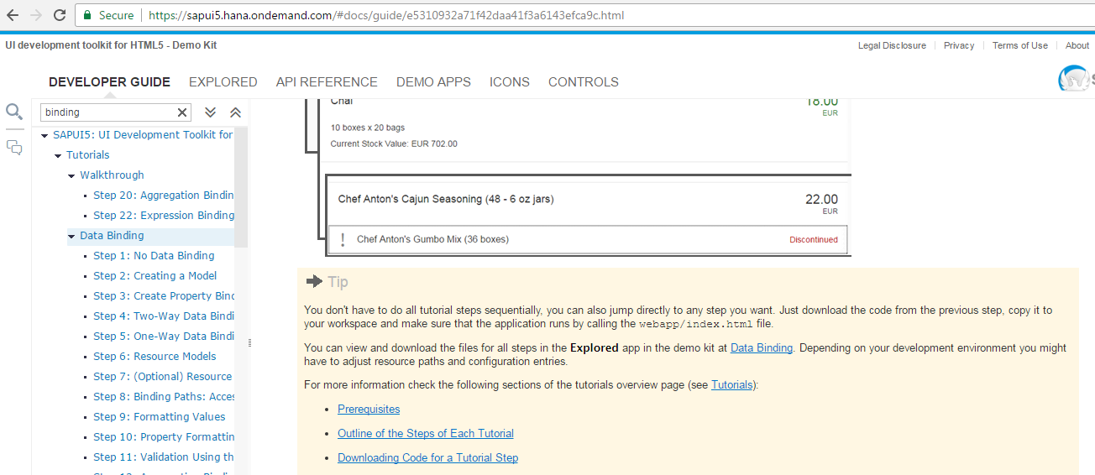
Data Binding

Slide 9
UI5I-UI5-02 : Types of UI Models

Slide 10
Model
we create a model as container for the data on which your application operates.
The business data within a model can be defined using various formats:
JavaScript Object Notation (JSON)
Extensible Markup Language (XML)
Odata
Resource Models

Slide 11
JSON Model
JSON model is used to bind JavaScript objects to controls. This data model is a client-side model and is suggested for small data sets. It doesn’t provide any mechanism for serverside paging or loading.
Key features include −
JSON model for data binding supports data in JavaScript notation format.
It supports two-way data binding.
Creating a model instance −
Var oModel = new sap.ui.model.json.JSONModel(dataUrlorData);

Slide 12
XML Model
XML model of data binding allows you to bind the controls to XML data. It is used for clientside objects and for small data sets. It doesn’t provide any mechanism for server-side paging or loading.
Key features include −
XML model of data binding supports XML data.
It also supports two-way data binding.
Creating a model instance −
Var oModel = new sap.ui.model.xml.XMLModel(dataUrlorData);

Slide 13
OData Model
OData model is a server-side model, so entire data is available at the server side. Client side can see only rows and fields and you can’t use sorting and filtering at the client side. There is a need to send this request to the server to complete these tasks.
Data binding in OData model is one way but you can enable two-way binding using experimental write support.
Key features include −
OData model of data binding supports Odata compliant data.
This data model allows you to create OData requests and handle responses.
It supports experimental two-way binding.

Slide 14
OData Model
Creating a model instance −
Var oModel = new sap.ui.model.odata.ODataModel (dataUrl [,useJSON, user, pass]);

Slide 15
Resource Models
Business applications also require language-specific (translatable) texts used as labels and descriptions on the user interface.
The example we used at the start of this tutorial was overly simplistic as we stored language-specific text directly in a JSON model object. Generally speaking, unless language-specific text is derived directly from a back-end system, it is not considered good programming practice to place translatable texts directly into a model. So let's correct this situation by placing all translatable texts (such as field labels) into a resource bundle.

Slide 16
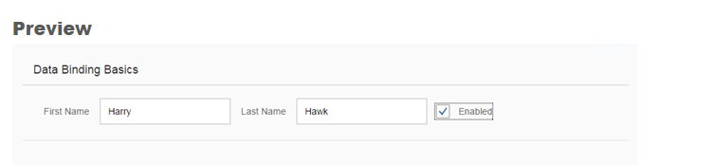
Resource Models

Slide 17
UI5I-UI5-03 : SAP UI5 Application Best Practices

Slide 18
SAP UI5 Application Best Practices
Preparing
Building
Index
Component
Navigation and Routing
Internationalization
Device Model
Custom Utilities
Model View Controller
Master View
Detail View
Detail XML Fragments

Slide 19
SAP UI5 Application Best Practices
Coding Issues to Avoid
JavaScript Code Issues
CSS Styling Issues

Slide 20
SAP UI5 Application Best Practices
JavaScript Coding Issues
Don't use private and protected methods or properties of UI5
Don't use deprecated APIs
Don't override or add control methods
Don't manipulate the DOM structure within controls
Don't attach DOM event handlers
Don't hard code or concatenate strings that need to be translatable
Don’t use console.log()
Use “jQuery.sap.log.info("some message");”

Slide 21
SAP UI5 Application Best Practices
CSS Styling Issues
Don't override control class styling directly
Don't style DOM element names directly
Don't use generated IDs in CSS selectors
Don't use hard-coded colors, font sizes and images if the app should be themable

Slide 22
UI5I-UI5-04 : Formatter and Validations on UI

Slide 23
Formatter
To modify the values at runtime sapui5 has provided formatter function concept.
format the value before its display.
Example:

Slide 24
Formatter
new sap.m.Input({
value: {
parts: [{
path: 'name'
}, {
path: 'surname'
}],
formatter: function(name, surname) {
var sFullname = name + ' ' + surname;
return sFullname;
},
}
})

Slide 25
Validation
You know those little red stars that we all know indicates a required field? Well we can do this in SAPUI5 as well.
The trick is to remember that this is usually indicated in the label, not the control
Example:
Use the “required” property to indicate that a control is mandatory.
tfdMineManager = new sap.ui.commons.TextField({ id : “tfdMineManagerID”, required : true, });

Slide 26
Validation
This is a common requirement, but you can replace the function with whatever your validation check should be.
Example:
var testPreCalibration = sap.ui.getCore().getControl(“PreCalibration”).getValue(); if ( ! sap.ui.controller(<my controller>).isNumberFieldValid(testPreCalibration) ){ sap.ui.getCore().getControl(“PreCalibration”).setValueState(sap.ui.core.ValueState.Error); }

Slide 27

Validation
isNumberFieldValid : function(testNumber){ var noSpaces = testNumber.replace(/ +/, ”); //Remove leading spaces var isNum = /^\d+$/.test(noSpaces); // test for numbers only and return true or false return isNum; };

Slide 28
UI5I-UI5-05 : Introduction to Fragments

Slide 29
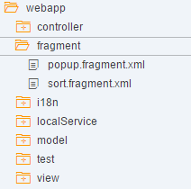
Fragments
Fragments is a technique used to split the codes into different files which will be dynamically called into a specified area in a UI5 page to get the final Output.
Fragments filesare created with the extension <fragmentname>.Fragment.Xml.

Slide 30
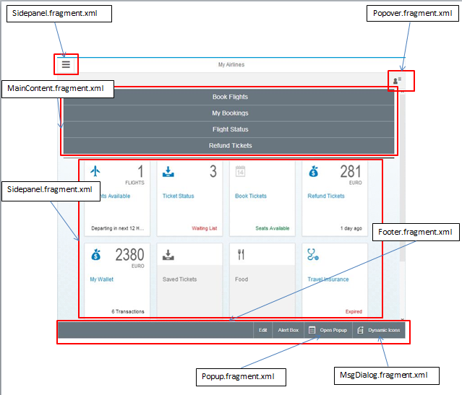

Fragment example

Slide 31
Useful links
SAP UI5 Demo kit- https://sapui5.hana.ondemand.com/sdk/#content/Controls/index.html
SCN Community page- http://scn.sap.com/community/developer-center/front-end
SAP UI5 testsuite- https://sapui5.hana.ondemand.com/sdk/test-resources/testsuite/testframe.html
Creating SAP UI5 Project http://scn.sap.com/docs/DOC-37805

Slide 32

Questions???

Slide 33


